Slide 1

Zillow Database Design and SQL Queries

Slide 2
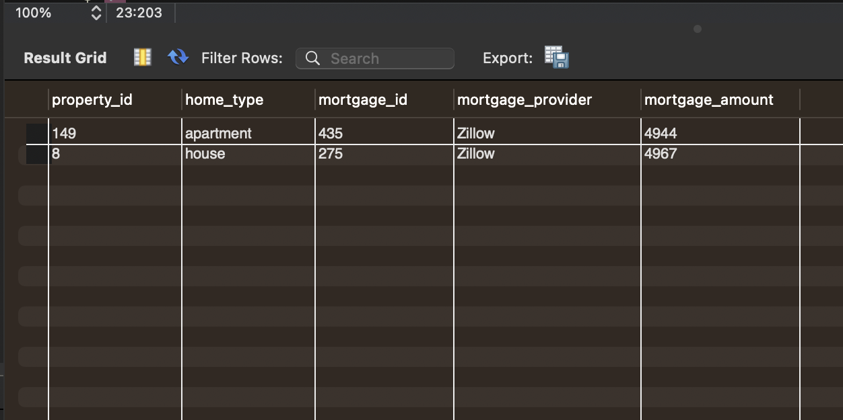
What is the top 5th ranked mortgage amount for each home type and show the provider names
Approach
Select property_id, home_type, mortgage_id, mortgage_provider, mortgage_amount from
(
select p.property_id, p.home_type, m.mortgage_id, m.mortgage_provider, m.mortgage_amount,
rank() over(partition by home_type order by mortgage_amount DESC) as amount_rank
from property_mortgage m
join property p
on p.property_id= m.property_id
) as ex
where amount_rank = 5;

Slide 3
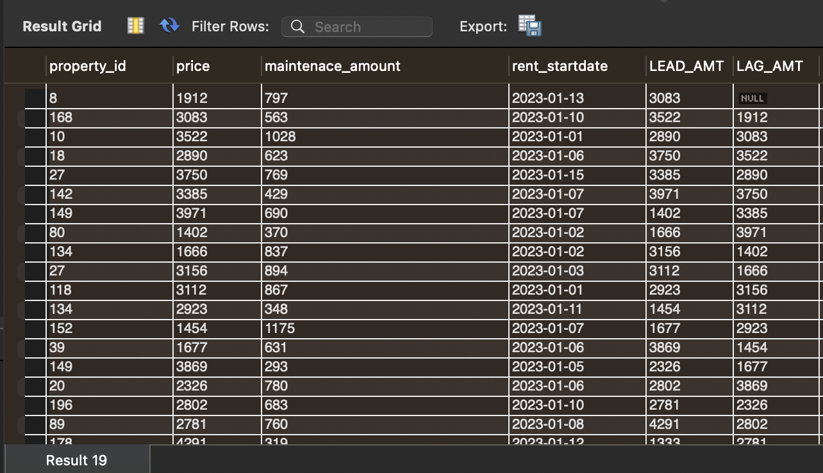
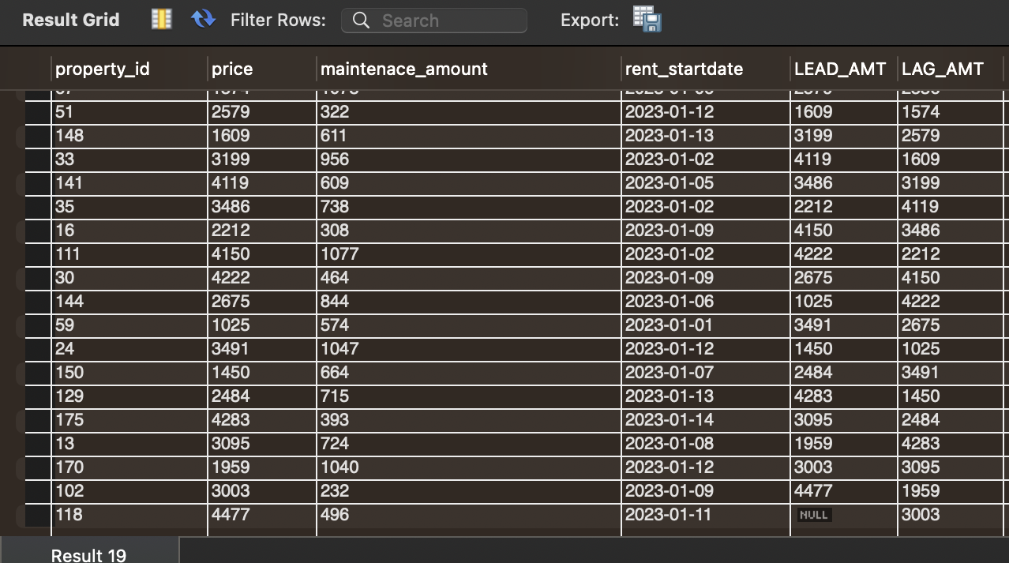
For each rent property show the rent (price) in the period between 1st Jan and 15th Jan 2023. show current rent and rent on the next day. Also, show the current rent and the rent on previous start date.
Approach
select p.property_id, r.price, r.maintenace_amount, r.rent_startdate,
lead(price) over(order by rent_id) as LEAD_AMT,
LAG(price) over(order by rent_id) as LAG_AMT
from rent_property r
inner join property p
on p.property_id = r.property_id
where rent_startdate between '2023-01-01' and '2023-01-15';

Slide 4
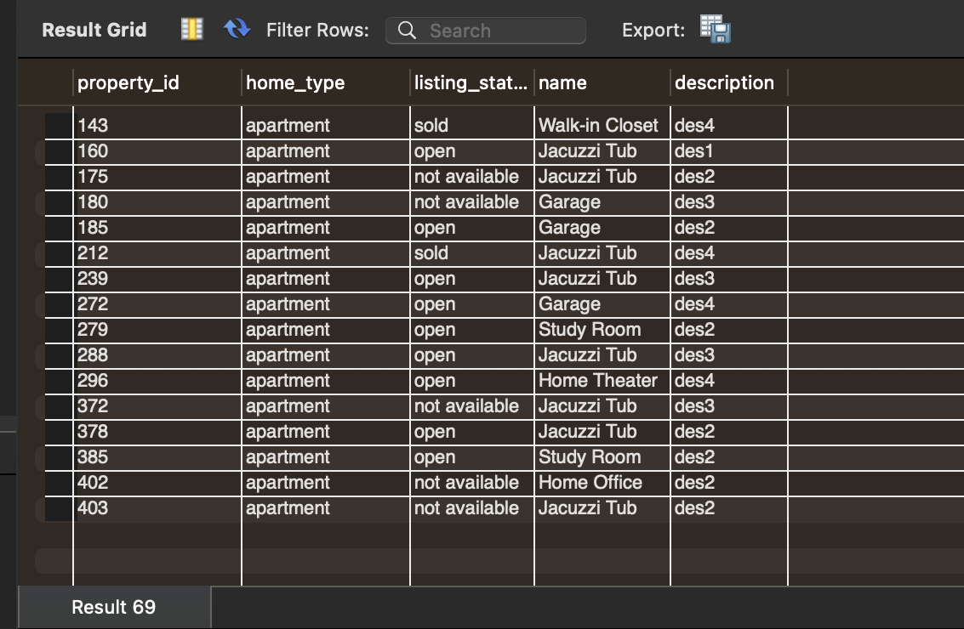
For each property show the amenities details show one more column availability when amenities are study room or Home Office "study area available' , for garage 'parking space available' else show other. When amenities not available show null values.
Approach
select p.property_id, p.home_type, a.amenities_id, a.name,
case when name = 'Study Room' or 'Home Office' then 'study area available'
when name = 'garage' then 'parking space available'
else 'other'
end as Availability
from amenities a
right join property p
on a.property_id = p.property_id;

Slide 5
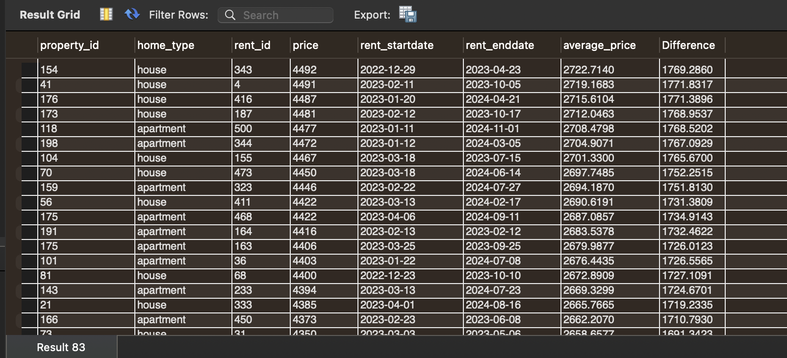
Find the rent for each property and find average rent. Find the difference between average rent and the rent show the highest rent first
Approach
select p.property_id, p.home_type, r.rent_id, r.price, r.rent_startdate, r.rent_enddate,
avg(price) over(order by price DESC rows between current row and unbounded following) as average_price,
price - avg(price) over(order by price DESC rows between current row and unbounded following) as Difference
from property p
left join rent_property r
on r.property_id = p.property_id;

Slide 6
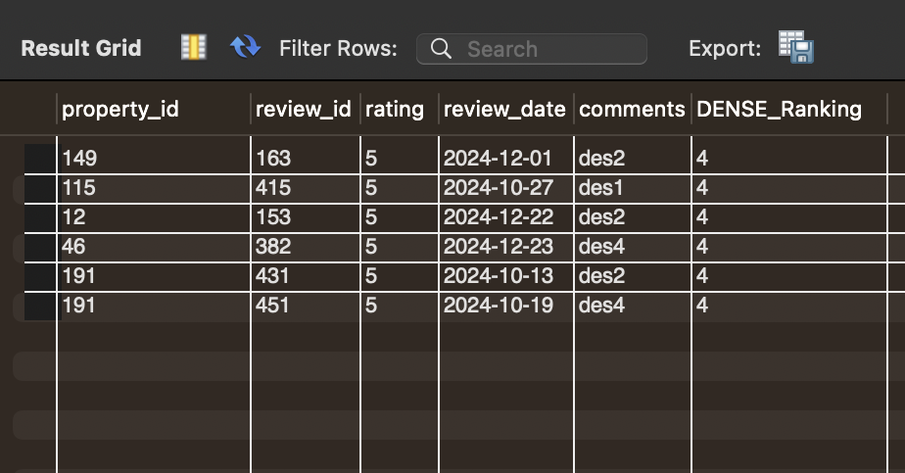
Show the all the property _id and review details with rating ranking top 4 form 10th Sept to 31st Dec 2024
Approach
Select property_id, review_id, rating,review_date, comments, DENSE_Ranking from
( Select p.property_id, r.review_id, r.rating, r.review_date, r.comments,
DENSE_RANK() OVER( order by rating) as DENSE_Ranking
FROM review r
join property p
on p.property_id = r.property_id) as ex
where review_date between '2024-09-10' and '2024-12-31'and
DENSE_Ranking = 4;

Slide 7
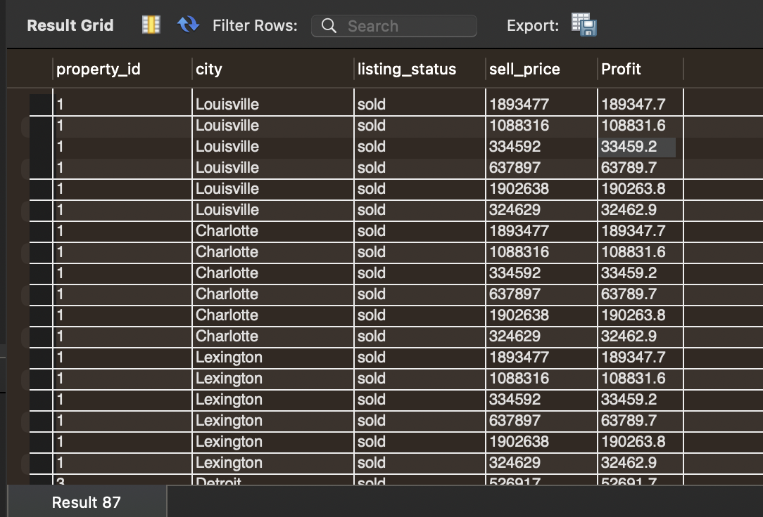
Zillow makes 10% profit on the selling price when property is sold. Show the profit made by zillow for each sold property according to city
Approach
select p.property_id, l.city, p.listing_status, b.sell_price, 0.1 * b.sell_price as Profit
from property p
join location l
on l.property_id=p.property_id
join buying_agreement b
on p.property_id = b.property_id
where p.listing_status = "sold";

Slide 8
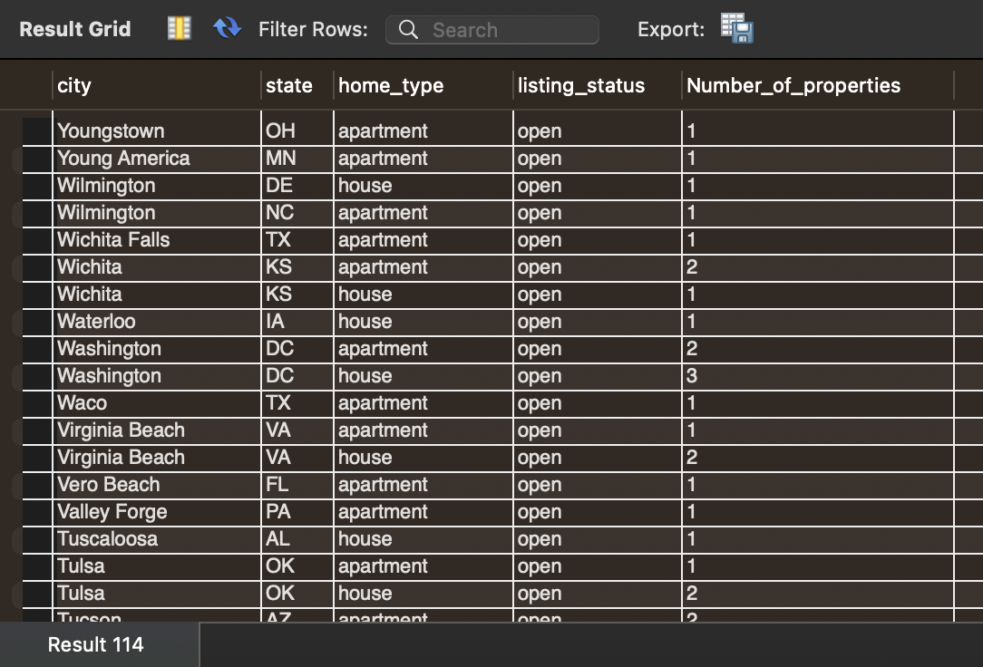
Number of properties per city and state where properties are available (listing_status = open)
Approach
select l.city, l.state, p.home_type, p.listing_status, count(distinct p.property_id) as Number_of_properties
from property p
inner join location l
on p.property_id = l.property_id
where listing_status = 'open'
group by city, state, p.home_type
order by city DESC;

